Slide 1
OPEN SOURCE
Linux
Mr. Aniket A. Firke
Developer’s Club Lead.

Slide 2
Agenda
OPEN SOURCE
Linux

Slide 3

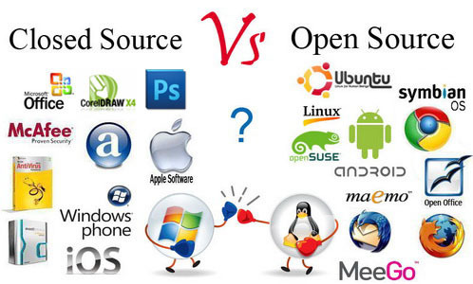
In production and development, open source is a philosophy, or a methodology that promotes free redistribution and access to a product's design or ideas and implementation details.
open as in free
open as in access
open as in over time
open as in not closed
open as in reuse and change
open as in any place and for anyone
View/Modify the source code of an application or software.
Open source software is released to the development community and undergoes a secondary phase of evolution, but closed source software is developed in isolation with a small team of developers.
Developer support and large community to help.
O Open Source is more secure and bugs and vulnerabilities are fixed often

Slide 4
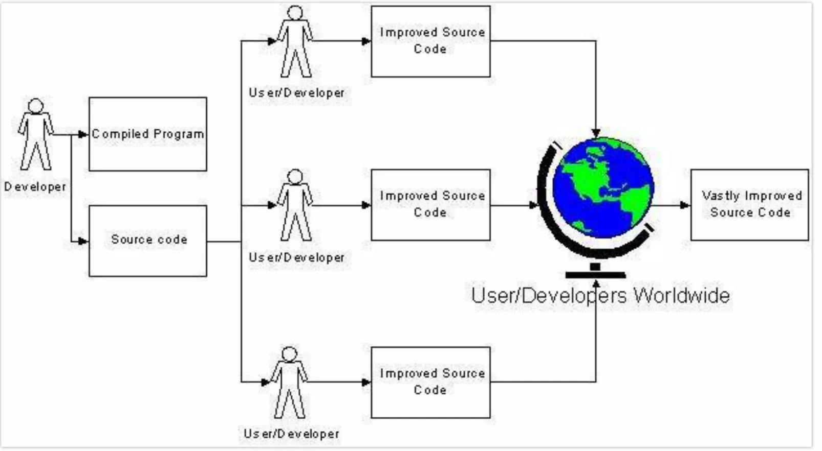
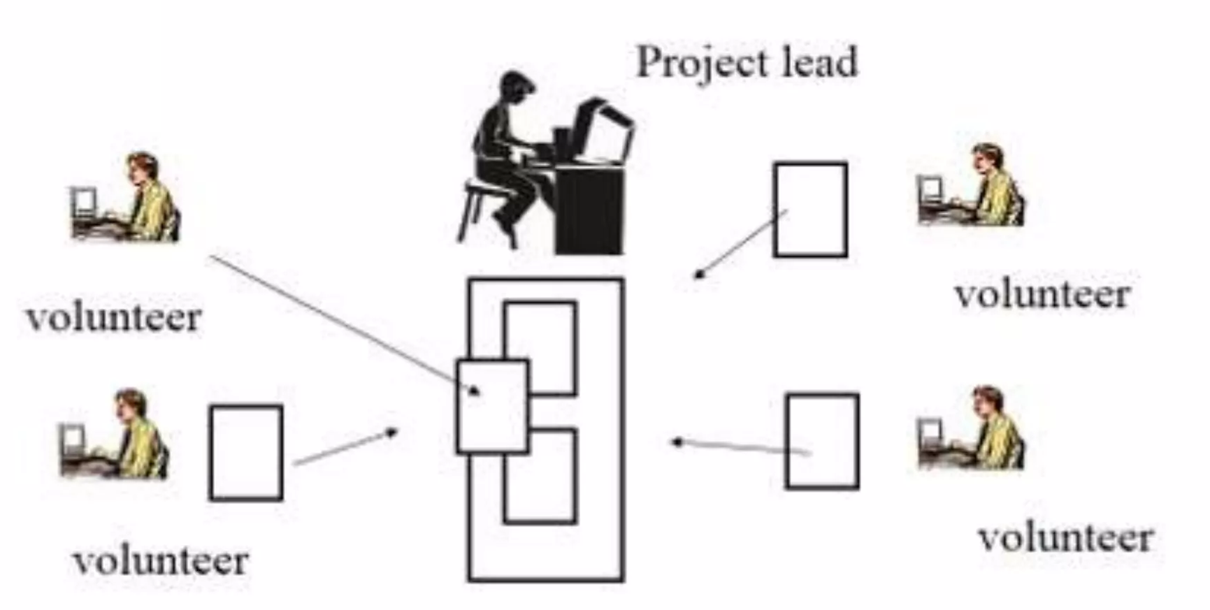

Slide 5
Availability of source code
Source code to understand and learn from
Do not have to re-invent the wheel
Free as in "freedom"
O Does not depend on vendor
Can choose additional support
Can fix bugs and adapt to change in requirements as well as technology
Quality and Customizability in open source is better.
Costs much less than proprietary counterparts.
Not generally straightforward to use and requires a certain learning curve to use and get accustomed.
Incompatibility issue with software and hardware. (3rd party drivers)
Bad Codes, and some unqualified people who uses it.
Software quality assurance process is widely not transparent
No financial incentive

Slide 6



Slide 7




Open Office: Apache OpenOffice is an open- source office productivity software suite with official website OpenOffice.org, launched in 2002 under the Apache License .
LibreOffice: Developed by The Document Foundation, it is licensed under the GNU Lesser General Public License (LGPL). It supports Windows, Macintosh and GNU/Linux systems.
Neo Office: Primarily designed for Mac users and is distributed under the GNU General Public License.
Koffice: It is a open source office suite licensed under the LGPL. It is available for Windows, Linux, FreeBSD and Mac OS X systems

